Slide 1
Mainstream: Dynamic Stem-Sharing for Multi-Tenant Video Processing
Angela Jiang, Daniel L.-K. Wong, Christopher Canel,
Lilia Tang, Ishan Misra, Michael Kaminsky,
Michael Kozuch, Babu Pillai,
David G. Andersen, Greg Ganger

Slide 2
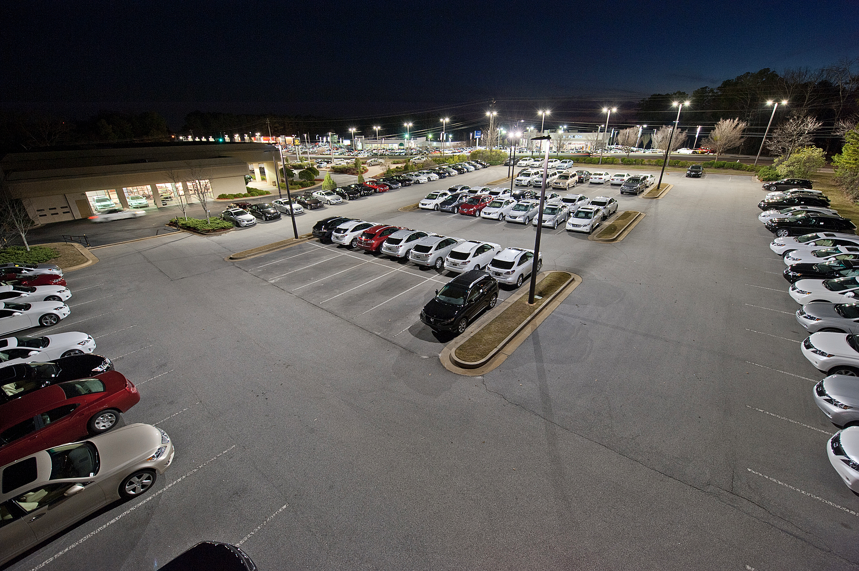
Parking violation monitor
Parking spot finder
Fender-bender monitor
Chevy Tahoe detector
Notes:
Imagine that you have a camera, generating a video stream of the parking lot. And this camera is attached to some edge compute resources. You can imagine that there are a lot ways you’d want to use these edge resources to analyze the video stream in real time

Slide 3
Mainstream: runtime optimization of applications
Problem #1: Video analysis applications do DNN inference
Running several full DNNs becomes very slow
Mainstream reduces contention by sharing redundant computation
Without centralized training data and process
Problem #2: Applications developed in isolation and offline
Without understanding of the resources available
Mainstream dynamically tunes DNNs at runtime
Notes:
Virtually infinite but constrained by cost
Nobody knows where this is going
late-binding
If your resources are finite, best accuracy occurs if the characteristics of how the app is doing in the analysis is specialized to the amount of resources we have. The close that people do is to assume infinte resources, or very limited and smallest that they can. It’s not really either and the person developing the app isn’t gonna know. Developed in isolation but not gonna run that way. Foffloatding the optimization steps to scheduling time. Run multiple apps . Specialize to amount of resources -> better behavior. Also know run multiple things on video streams. App developer that’s assuming theres is the only thing can’t possibly know what’s going to available, 1) where they’re running probably won’t know 2) what they’re sharing with, definitely won’t know. Make those deciisions at the time where they’re known which is scheduling time and enact decisions then
Maybe no edge node or datacenter
Do best when you know
Can’t know at app development time
Only know at runtime
_why_ it’s unknown

Slide 4
Mainstream challenges and solutions
!
Concurrent DNN inference is slow
✓
Mainstream shares redundant computation
!
Deployed apps are tuned in isolation and offline
✓
Mainstream dynamically tunes DNNs at runtime
Notes:
Usually transfer learned, and usually transfer learned using same base application
But network is trained independently (nobody ever remembers that they’re off the same base, we think there’s an opportunity there to share part of the network)

Slide 5
Mainstream takeaways
1
Merge video stream processing of concurrent apps
By sharing redundant computation
2
2
Dynamically tune degree of specialization at runtime
Dynamically tune degree of specialization at runtime
3
3
Up to 87x improvement in F1-score
Up to 87x improvement in F1-score
Compared to No Sharing
Compared to No Sharing
4
4
Up to 47% improvement in F1-score
Up to 47% improvement in F1-score
Compared to Max Sharing
Compared to Max Sharing

Slide 6
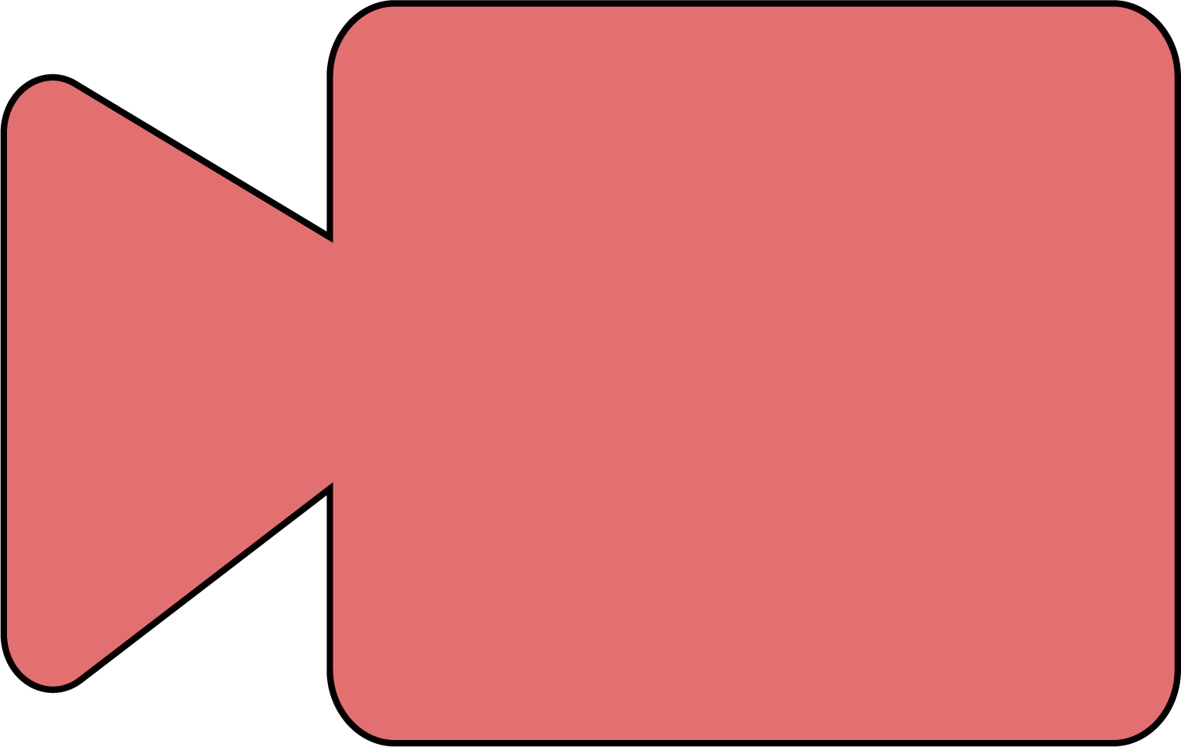
Example video analysis pipeline
Decode
Transform
Classify
Post-process
Edge Node

Slide 7
DNN is primary cost of pipeline
Classify (DNN)
Notes:
Give specific numbers
DNN
Talk about the change before it happens on the slide

Slide 8
DNN is primary cost of pipeline
Classify (DNN)
Classify (DNN)
Classify (DNN)
Notes:
Give specific numbers
DNN
Talk about the change before it happens on the slide

Slide 9
In mainstream: partial sharing of 3 DNNs
Efficiently run same 3 DNNs

Slide 10
How to find redundancy between DNNs?

Slide 11
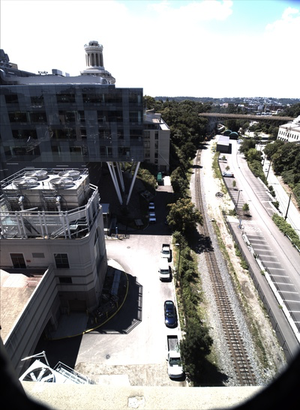
Basic dnn
.6
.1
.2
.1
Notes:
DNN/transfer learning background

Slide 12
Training a DNN
Notes:
DNN/transfer learning background

Slide 13
Training a DNN
Notes:
DNN/transfer learning background

Slide 14
Training a DNN
Notes:
DNN/transfer learning background

Slide 15
Fine-tuning dnn #1
Notes:
DNN/transfer learning background
There are common, industry standard models to use, that facilitate sharing

Slide 16
Fine-tuning dnn #1
Notes:
DNN/transfer learning background

Slide 17
Fine-tuning dnn #1
Notes:
DNN/transfer learning background

Slide 18
Fine-tuning dnn #1
Notes:
DNN/transfer learning background

Slide 19
Fine-tuning dnn #2
Notes:
DNN/transfer learning background

Slide 20
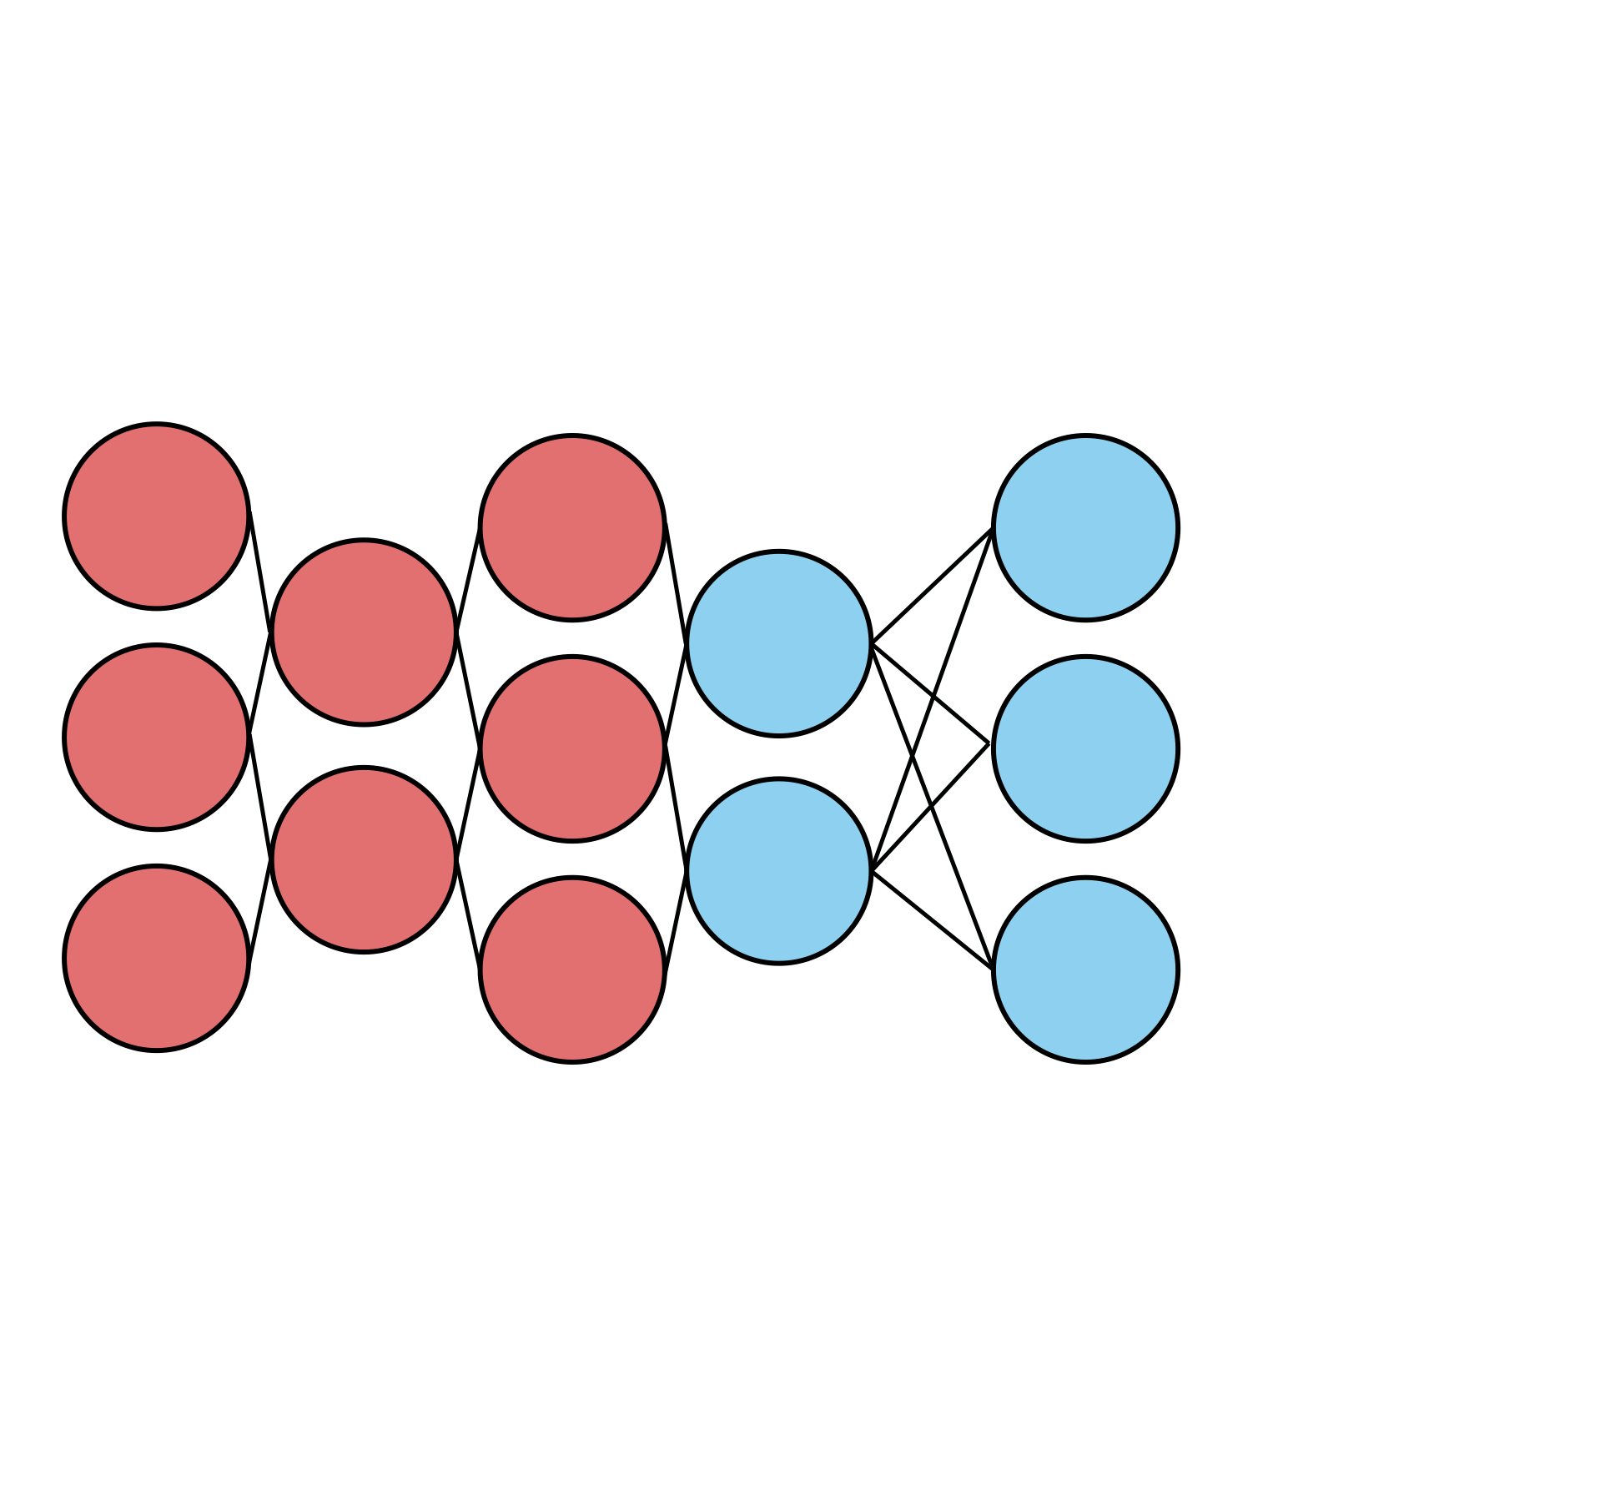
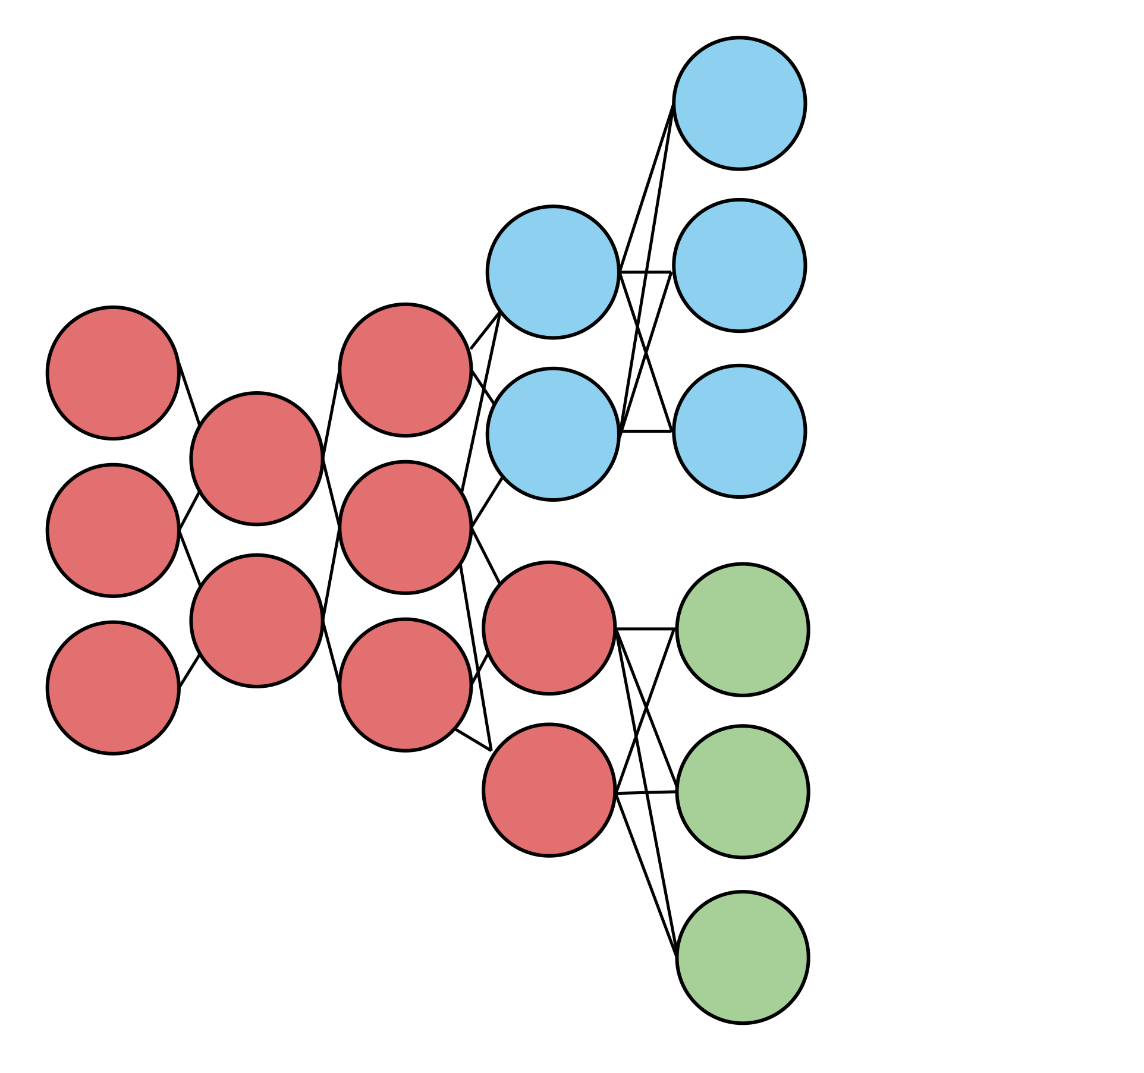
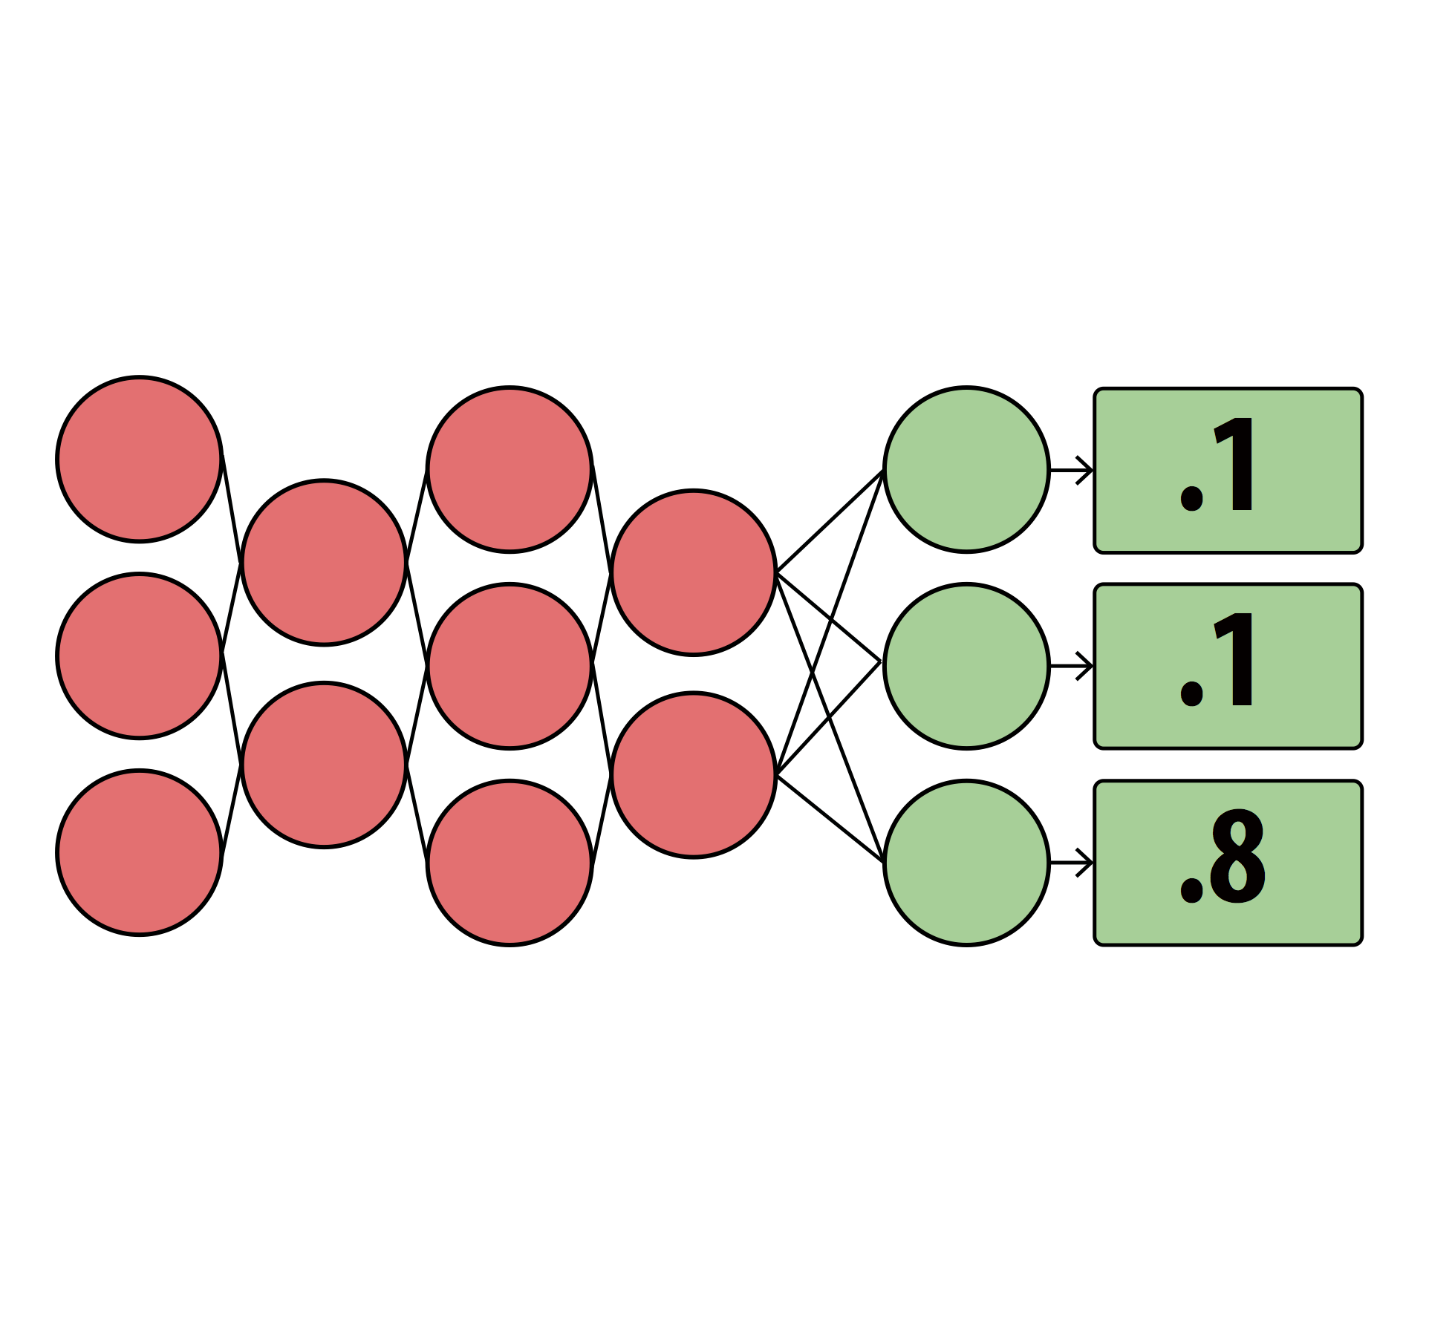
Fine-tuning dnn #1
Notes:
And you don’t know if that there’s similarities between with them. Did all of the red stuff twice. Base piece of our opportuniy. REd stuff doesn’t have to be done twicwe
Because the output of the red stuff is gonna be identical. Animate in merged DNNed. Number of bubbles you have to process are smaller, and if you have milions of bubbldes but hundreds of thousands of red bubbles

Slide 21
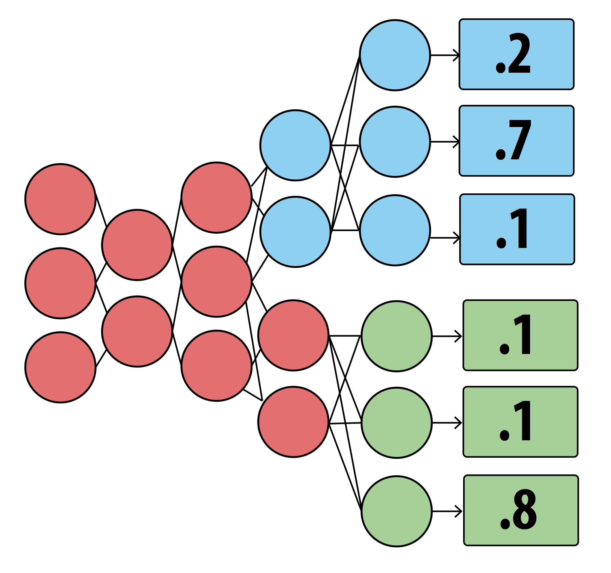
Two dnns as run in mainstream

Slide 22
Mainstream takeaways
1
Merge video stream processing of concurrent apps
By sharing redundant computation
2
Dynamically tune degree of specialization at runtime
3
3
Up to 87x improvement in F1-score
Up to 87x improvement in F1-score
Compared to No Sharing
Compared to No Sharing
4
4
Up to 47% improvement in F1-score
Up to 47% improvement in F1-score
Compared to Max Sharing
Compared to Max Sharing

Slide 23
Performance trade-offs from specialization

Slide 24
More sharing = Higher throughput
More specialization = Higher per-frame acc.

Slide 25
Experimental setup
Run concurrent image classification pipelines
Performed with InceptionV3 and MobileNets-224 DNNs
Hardware: Intel NUC
Video stream: 20FPS, 640x480
Decode
Transform
Classify
Post-process

Slide 26
Less specialized ➝ faster processing
Running image classifiers with InceptionV3
Notes:
Build this
Talk about red line first and more
That change dramatically as soon as we add one more app

Slide 27
Less specialized ➝ lower per-frame acc

Slide 28
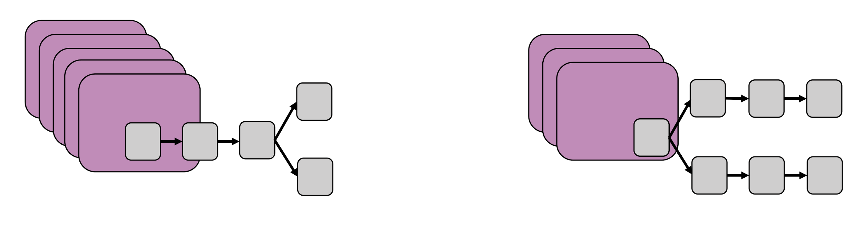
Sample more or specialize more?
Notes:
Use actual frames

Slide 29
Based on application performance
Two contributions
How to measure application performance
Analytical model for doing it efficiently
Notes:
Use actual frames

Slide 30
How do we measure application performance?

Slide 31
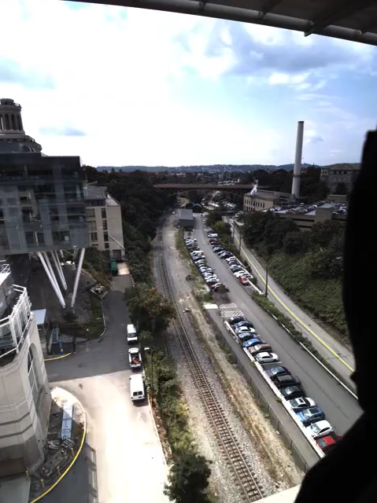
Application example:
Event detection
Notes:
Grey out
Hammer on *front* of the train, so needs to be one of the two

Slide 32
Goal: maximize event f1-score
Event-Recall How many relevant events are detected?
Event-Precision How many detected events are relevant?
Event-F1 score Harmonic mean between precision and recall
Notes:
Precision -> opposite of FNR

Slide 33
Effect of accuracy and fps on f1-score

Slide 34
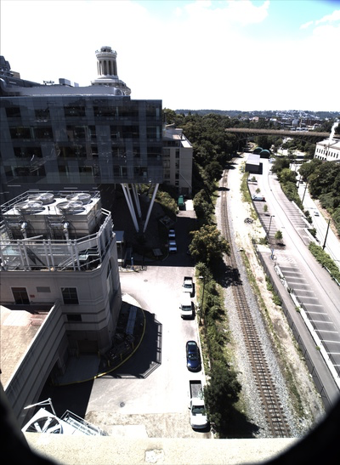
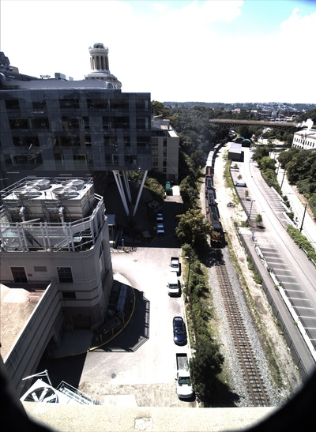
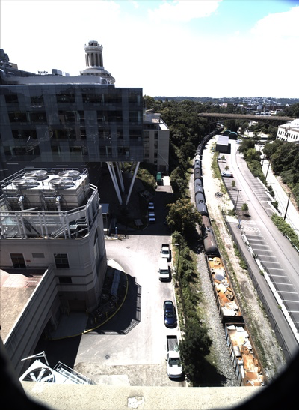
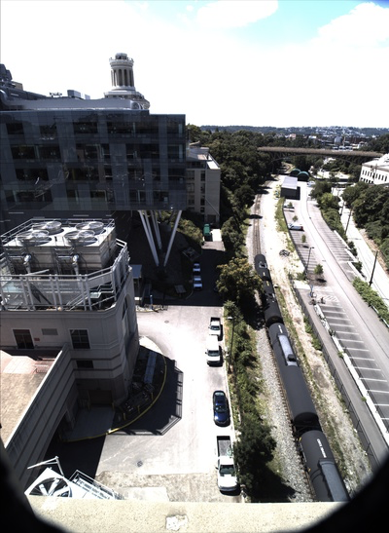
Notes:
Grey out
Hammer on *front* of the train, so needs to be one of the two

Slide 35
Notes:
Grey out
Hammer on *front* of the train, so needs to be one of the two

Slide 36
Notes:
Grey out
Hammer on *front* of the train, so needs to be one of the two

Slide 37
Notes:
Grey out
Hammer on *front* of the train, so needs to be one of the two

Slide 38
Notes:
Grey out
Hammer on *front* of the train, so needs to be one of the two

Slide 39
Challenge of searching the state-space
Requires joint optimization between applications
Combinatorially large state space
Analytically model the function between FPS, accuracy and F1-score
Notes:
Precision -> opposite of FNR

Slide 40
Estimating application quality
Notes:
Precision -> opposite of FNR

Slide 41
Estimating application quality
Notes:
What you say for the first frame is the same as what you’ll say for the second frame

Slide 42
Estimating application quality
Notes:
Precision -> opposite of FNR

Slide 43
Mainstream architecture

Slide 44
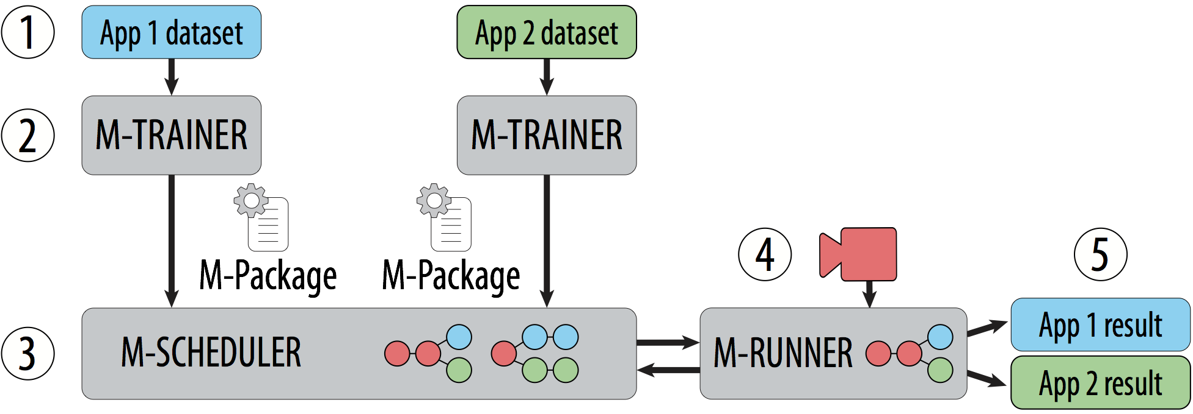
Mainstream architecture

Slide 45
Decentralized, sharing-aware training
% specialized | Top1 Acc. | Model
Minimum event length = 50ms
Inter-frame correlation = 0.8
Notes:
In Mainstream training does not require centralized control of the data or training process
Each M-trainer is run locally by the app developer
It helps the app developer create and save the necessary information for scheduler to determine the amount of specialization at runtime
In particular, M-trainer creates model sets. So, instead of training one model, it trains multiple model candidates, each with a different amount of specialization (aka sharing potential)
It also saves important metadata
Most importantly, our model sets allow the late binding of how much specialization is used at runtime
And M-Trainers can be run independently and at different times by the application developer

Slide 46
Mainstream architecture

Slide 47
Dynamic, sharing-aware scheduling
Input: M-Package
Model Sets, Min event length, Inter-frame correlation
Output: Number of task-specific layers and frame-rate (per application)
Maximize: F1-score (across applications)
Approach: Greedily choose moves with maximum cost-benefit ratio
Benefit: from analytical model
Cost: Relative latency-based cost
Use X-voting to improve precision
Notes:
WITHIN A COMPUTATIONAL BUDGET (modeled as a cosest)

Slide 48
Mainstream results

Slide 49
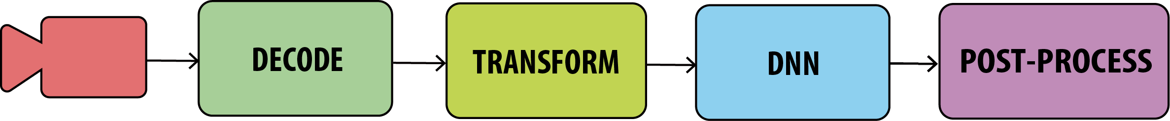
Experimental setup
Run concurrent image classification pipelines
Using MobileNets-224 DNNs
Tasks: Pedestrian, Bus, Red Car, Scramble, Schoolbus, Trains, Car
Hardware: Intel NUC
Video stream: 20FPS, 640x480
Decode
Transform
Classify
Post-process

Slide 50
Mainstream improves event f1-score by 87x
Notes:
We compare against 2 static approaches
No sharing is one end of the extreme where we deploy a full DNN for every applications
Max sharing conservatively shares all but the last layer
No sharing performs well when resources aren’t constrainted and it’s able to run its fully-specialized networks at a high enough frame rate
No Sharing’s frame-rate degrades quickly and it soon begins to miss events
Max sharing is able to scale a lot better, but often underutilizes resources, never achieving a high model accuracy

Slide 51
Mainstream improves event f1-score by 87x
Frame rel acc: 1
2.3 FPS
Notes:
We compare against 2 static approaches
No sharing is one end of the extreme where we deploy a full DNN for every applications
Max sharing conservatively shares all but the last layer
No sharing performs well when resources aren’t constrainted and it’s able to run its fully-specialized networks at a high enough frame rate
No Sharing’s frame-rate degrades quickly and it soon begins to miss events
Max sharing is able to scale a lot better, but often underutilizes resources, never achieving a high model accuracy

Slide 52
Mainstream improves event f1-score by 87x
Frame rel acc: 1
0.36 FPS
Notes:
We compare against 2 static approaches
No sharing is one end of the extreme where we deploy a full DNN for every applications
Max sharing conservatively shares all but the last layer
No sharing performs well when resources aren’t constrainted and it’s able to run its fully-specialized networks at a high enough frame rate
No Sharing’s frame-rate degrades quickly and it soon begins to miss events
Max sharing is able to scale a lot better, but often underutilizes resources, never achieving a high model accuracy

Slide 53
Mainstream improves event f1-score by 87x
Frame rel acc: .59
6.8 FPS
Notes:
We compare against 2 static approaches
No sharing is one end of the extreme where we deploy a full DNN for every applications
Max sharing conservatively shares all but the last layer
No sharing performs well when resources aren’t constrainted and it’s able to run its fully-specialized networks at a high enough frame rate
No Sharing’s frame-rate degrades quickly and it soon begins to miss events
Max sharing is able to scale a lot better, but often underutilizes resources, never achieving a high model accuracy

Slide 54
Mainstream improves event f1-score by 87x
Frame rel acc: .59
6.8 FPS
Notes:
We compare against 2 static approaches
No sharing is one end of the extreme where we deploy a full DNN for every applications
Max sharing conservatively shares all but the last layer
No sharing performs well when resources aren’t constrainted and it’s able to run its fully-specialized networks at a high enough frame rate
No Sharing’s frame-rate degrades quickly and it soon begins to miss events
Max sharing is able to scale a lot better, but often underutilizes resources, never achieving a high model accuracy

Slide 55
Mainstream improves event f1-score by 87x
Frame rel acc: 0.96
5.9 FPS
Notes:
We compare against 2 static approaches
No sharing is one end of the extreme where we deploy a full DNN for every applications
Max sharing conservatively shares all but the last layer
No sharing performs well when resources aren’t constrainted and it’s able to run its fully-specialized networks at a high enough frame rate
No Sharing’s frame-rate degrades quickly and it soon begins to miss events
Max sharing is able to scale a lot better, but often underutilizes resources, never achieving a high model accuracy

Slide 56
Mainstream improves event f1-score by 87x
Frame rel acc: 0.9
5.6 FPS
Notes:
We compare against 2 static approaches
No sharing is one end of the extreme where we deploy a full DNN for every applications
Max sharing conservatively shares all but the last layer
No sharing performs well when resources aren’t constrainted and it’s able to run its fully-specialized networks at a high enough frame rate
No Sharing’s frame-rate degrades quickly and it soon begins to miss events
Max sharing is able to scale a lot better, but often underutilizes resources, never achieving a high model accuracy

Slide 57
Mainstream takeaways
Enables efficient processing of a set of dynamic applications
By sharing DNN computation
Determines how much of each network to specialize at runtime
Up to 87X improvement in F1-score, compared to No Sharing
Up to 47% improvement in F1-score, compared to Max Sharing

Slide 58
Mainstream takeaways
1
Merge video stream processing of concurrent apps
By sharing redundant computation
2
Dynamically tune degree of specialization at runtime
3
Up to 87x improvement in F1-score
Compared to No Sharing
4
Up to 47% improvement in F1-score
Compared to Max Sharing
Notes:
Enables efficient processing of set of apps

